Slide 1
COVID Impact on NORTHERN VA TRAFFIC
ibm CAPSTONE PROJECT 2021

Slide 2
COMPARING PRE-COVID TRAFFIC CONDITIONS TO COVID TRAFFIC CONDITIONS
In the early months of 2020, COVID-19 took ahold of American society and changed the way we functioned on a day-to-day basis.
Residents in the region quickly began performing their jobs remotely, decreasing the amount of traffic on the roadways
In this report I’ll examine how these changes affected traffic accidents in the region
Understanding these changes can help;
Government & Corporate leaders anticipate changes in traffic accidents as residents return to work
Residents better prepare for the roadways as they return to work

Slide 3
Data acquisitions & cleansing
A Kaggle dataset collected by Lyft Research Scientist, Sobhan Moosavi.
Data continuously collected from February 2016
The dataset consist of roughly 4.2 million accidents recorded across 49 states
Data Cleansing
Columns with large amounts of information were dropped
Data was filtered to only include data from accidents in Virginia
2 separate dataframes were created for comparisons
Nova2019: data from cities in Northern VA in 2019
Nova2020: data from cities in Northern VA in 2020

Slide 4
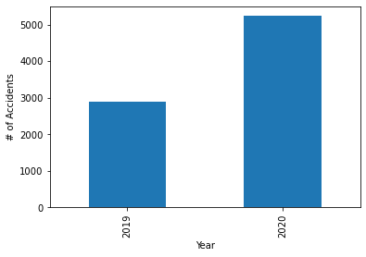
2019 vs 2020: Total accidents
There was an 80.49% increase in accidents from Pre-COVID conditions to COVID conditions in the Northern VA region.

Slide 5
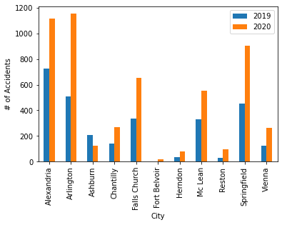
2019 vs 2020: comparison by city
Overall, there was an average 124% increase in accidents across all cities , with the largest change occurring at Fort Belvoir (425% increase). We conclude that the increase in accidents was region wide and not specific to any one city.
City | 2019 | 2020 | % Change
Alexandria | 724 | 1118 | 54.4%
Arlington | 511 | 1153 | 125.6%
Ashburn | 210 | 126 | -40.0%
Chantilly | 141 | 270 | 91.4%
Falls Church | 338 | 651 | 92.6%
Fort Belvoir | 4 | 21 | 425.0%
Herndon | 35 | 77 | 120.0%
Mc Lean | 332 | 554 | 66.8%
Reston | 31 | 99 | 219.3%
Springfield | 451 | 905 | 100.6%
Vienna | 124 | 262 | 111.2%

Slide 6
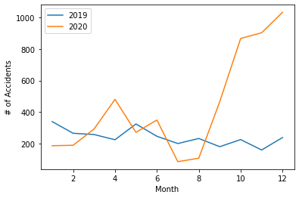
2019 vs 2020: timeline comparison
On average each quarter increased by 92%, while quarter 4 increased by 348% percent in 2020
Overall, 53% of all accidents in 2020 occurred in quarter 4, while only 21.5% of total accidents in 2019 occurred in quarter 4.
From this data we can conclude that quarter 4 was the only quarter in the 2020 that saw a significant increase in accidents.

Slide 7
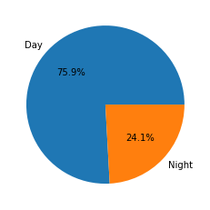
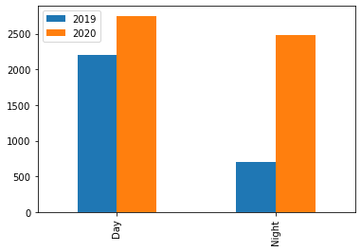
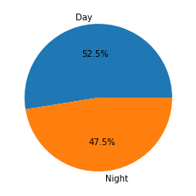
2019 VS 2020: TIME OF DAY COMPARISON
The main finding observed in the time-of-day data was that majority of the increase in accidents in 2020 occurred at night.
Overall daytime accidents increased by 25% in 2020, while nighttime accidents occurred by a staggering 255%.
From this data we could easily conclude that more accidents occurred at night during COVID compared to a more even distribution with daytime pre-COVID.
2019 ACCIDENTS
2020 ACCIDENTS

Slide 8
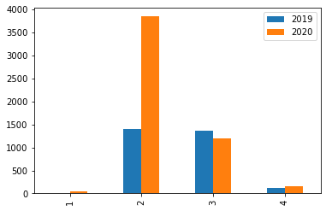
2019 VS 2020: SEVERITY COMPARSION
On average each severity category increased by 60% from 2019 to 2020.
The largest increased occurred in category 2 where a 174% in accidents occurred.
It can be concluded that overall, the distribution of data across the different severity categories stayed consistent except category 2.

Slide 9
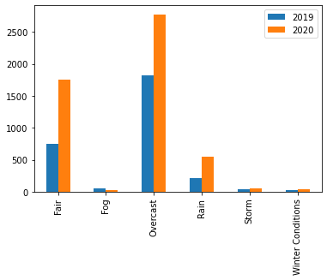
2019 vs 2020: weather comparison
On average each weather category saw a 67% increase between 2019 and 2020.
Fair and Rain categories were the two areas that saw significant increase, 157% and 136% respectively.
Proportionally the weather category accident distributions stayed the same with overcast weather have the strongest correlation with accidents.

Slide 10
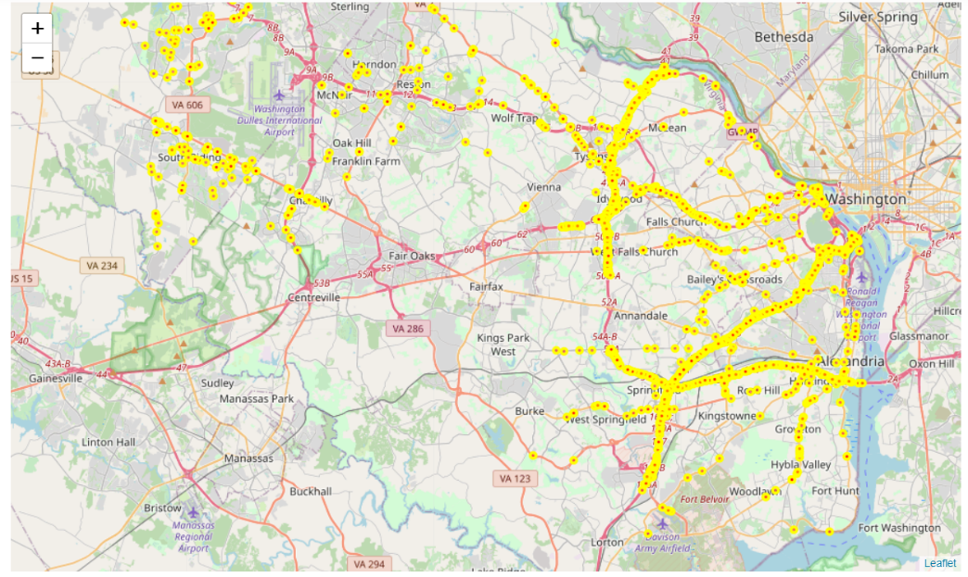
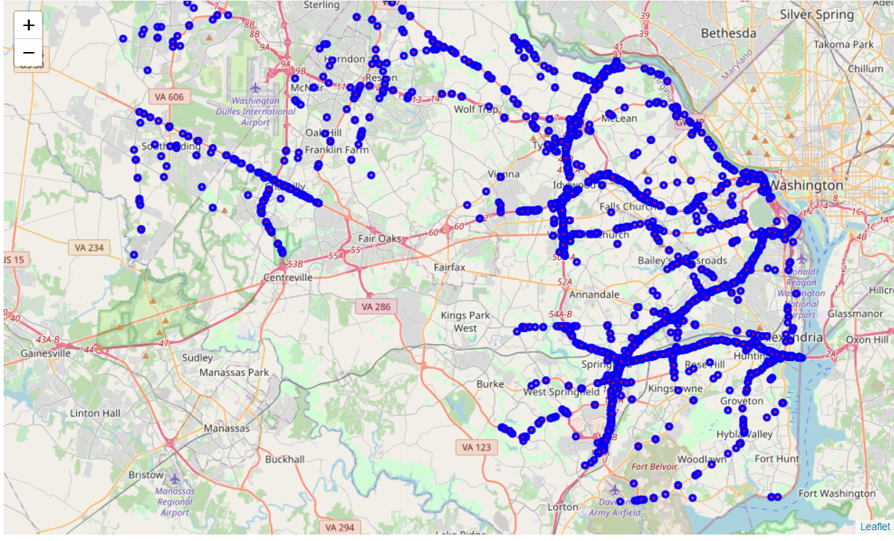
2019 vs 2020: accidents plotted
2019 Accidents
2020 Accidents

Slide 11
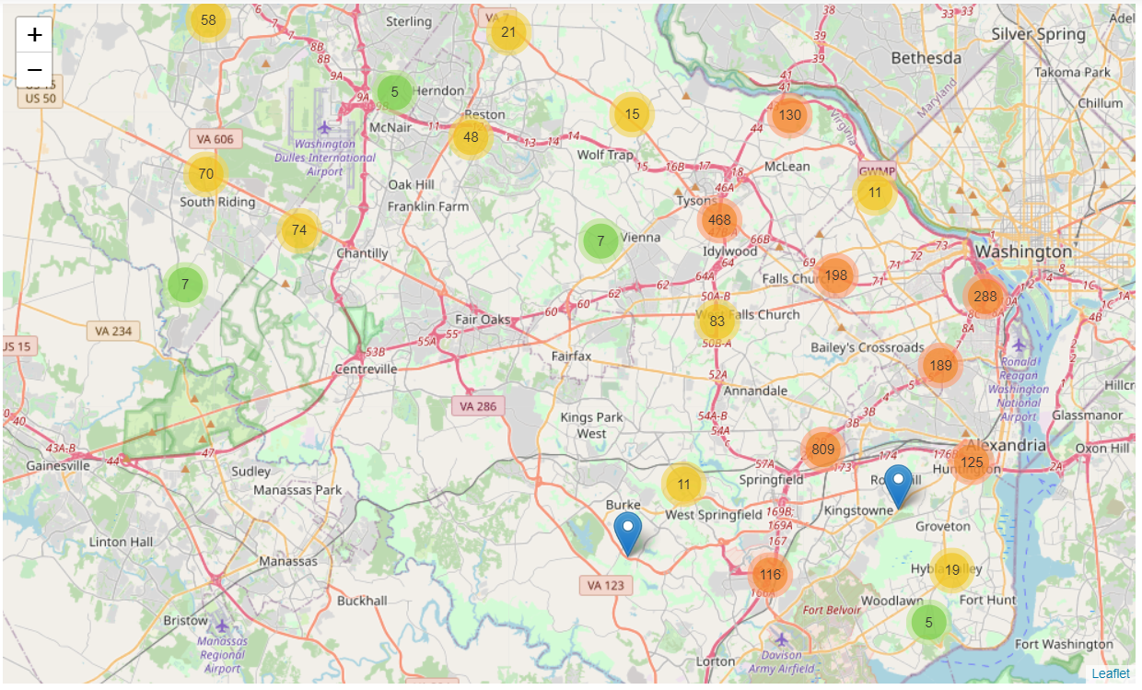
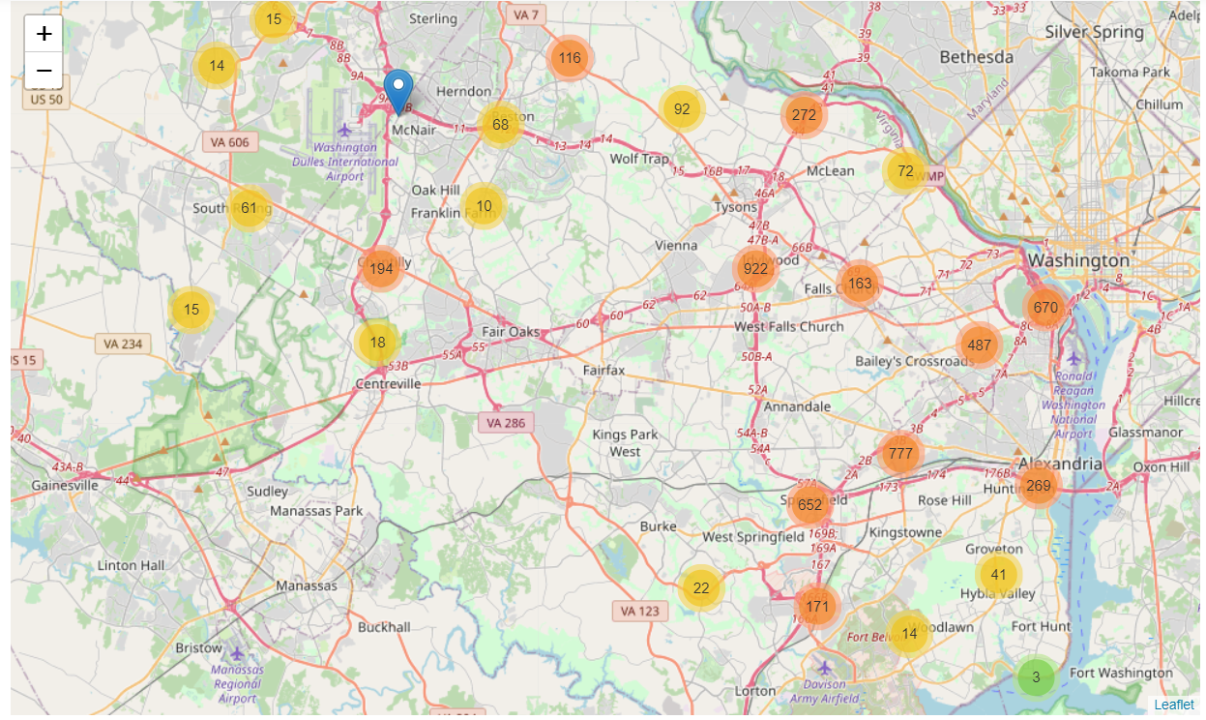
2019 vs 2020: accidents plotted
2019 Accidents
2020 Accidents

Slide 12
Conclusion
In this study, I analyzed the differences in traffic accident data between 2019 and 202 to determine the impact COVID-19 has had on traffic accidents in the Northern VA region.
I identified how location, time of day, weather, time of year, and severity influenced the number of accidents that occurred.
It can be concluded that COVID conditions have:
Caused an increase in traffic accidents
Shifted more accidents to occurring at night
This information can help leaders in the region anticipate changes in traffic accidents as working conditions return to normal

